Slide 1
Checking and Savings
A Follow-Up to
“Checking Accounts and Everyday Banking”

Slide 2
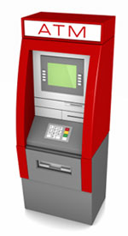
ATM
Automated teller machine
Convenient banking
Watch for fees

Slide 3
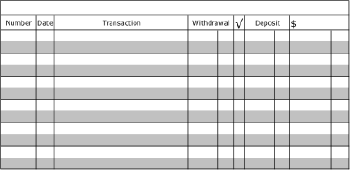
Check Register
Record of transactions

Slide 4
E-Banking
Using the internet to make payments, deposit paychecks, and transfer money

Slide 5
FDIC
Federal Deposit Insurance Corporation
Government program that ensures the safety of your money when used at banks

Slide 6
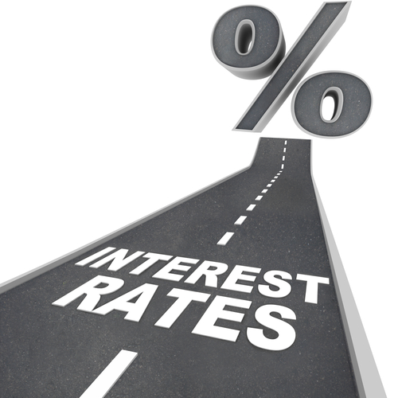
Interest
Money paid to banks, lending agencies, and individuals to borrow money

Slide 7
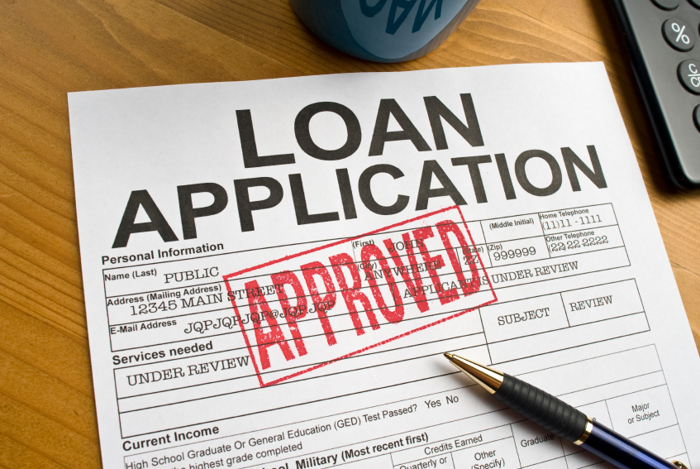
Loan
Money borrowed with the promise to pay back

Slide 8
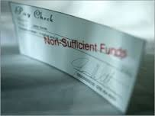
Overdraft Fee
Fee charged when someone does not have enough money in an account

Slide 9
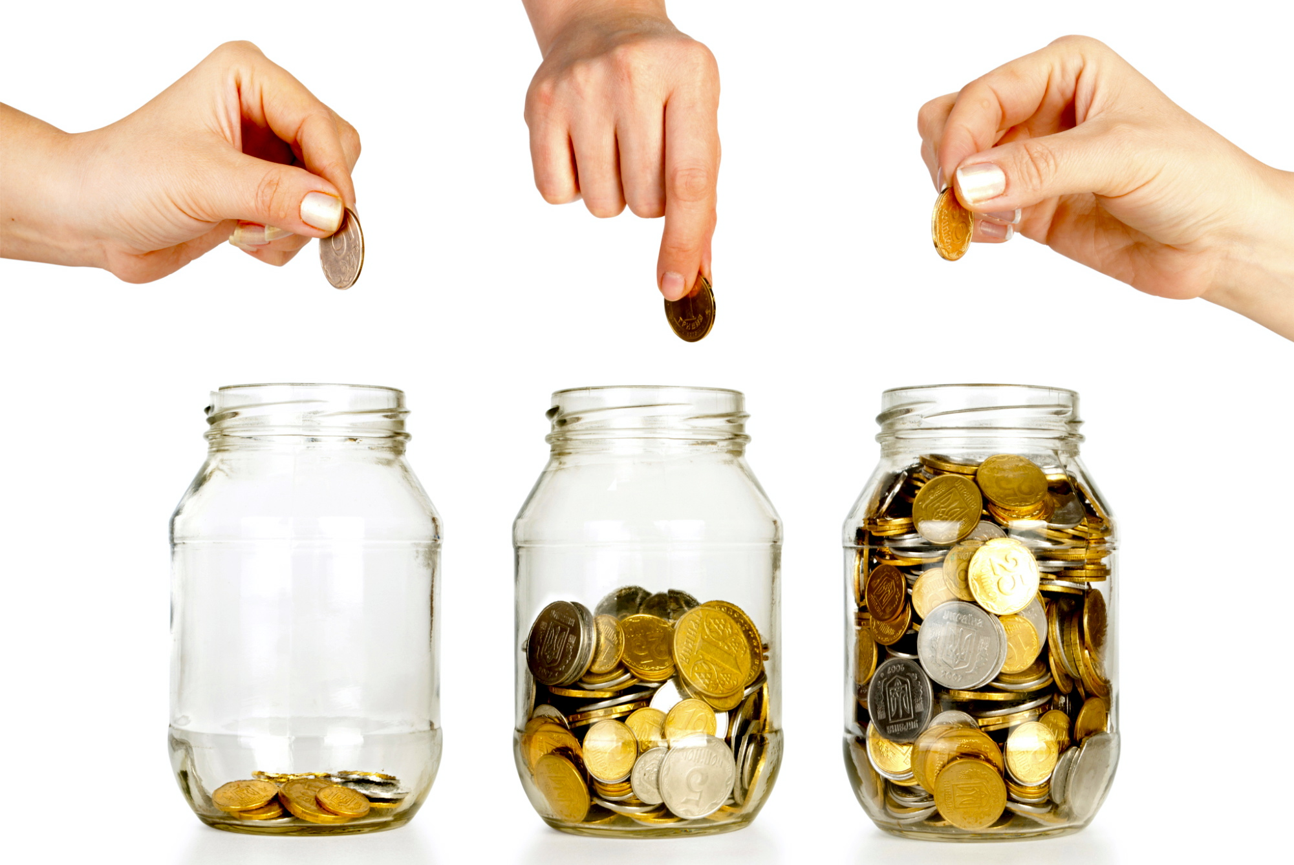
Savings
Putting money aside to be used later

Slide 10
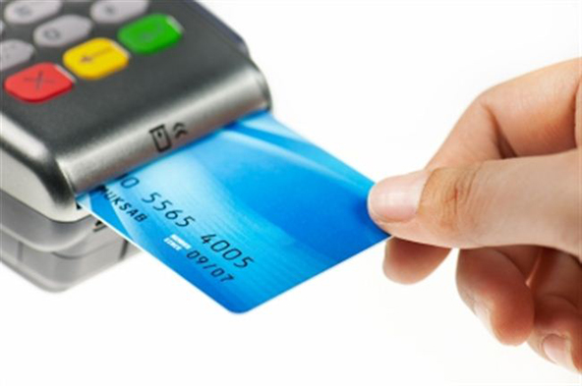
Transaction
Any time one spends money or earns money

