Slide 1
Children’s Literature
Reading and Development

Slide 2
Think about it…
What’s your most memorable childhood book?

Slide 3
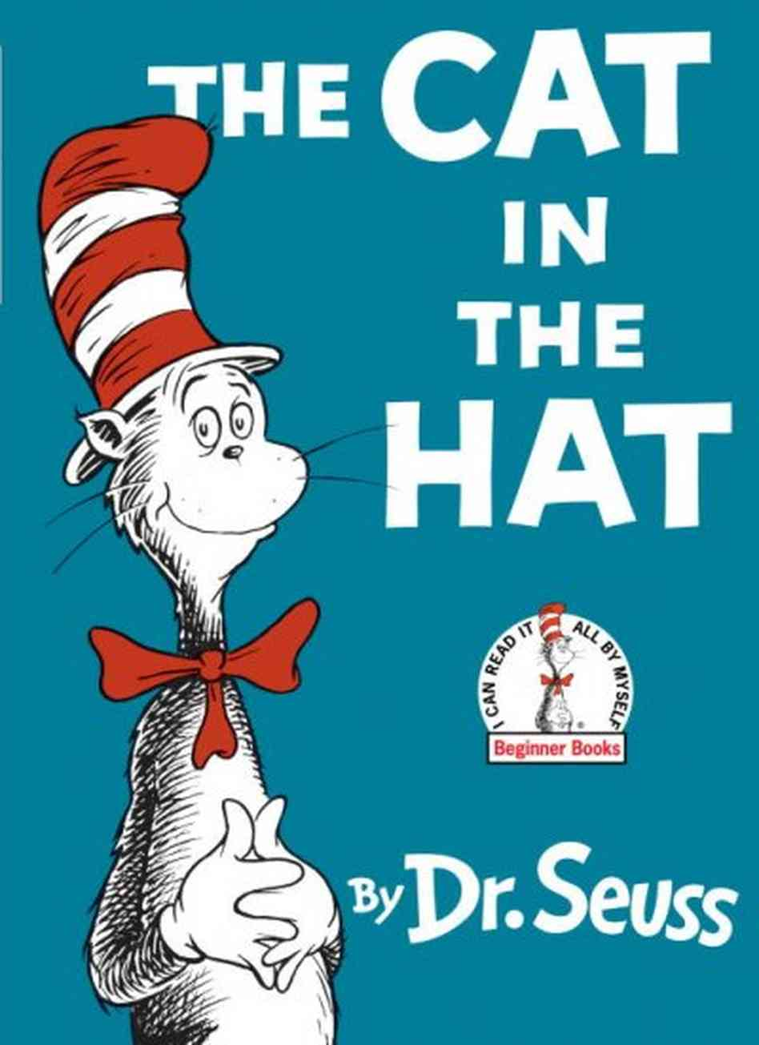

Slide 4


Slide 5
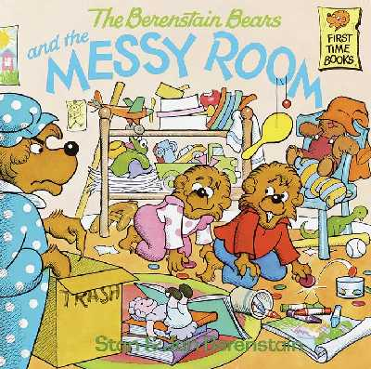

Slide 6
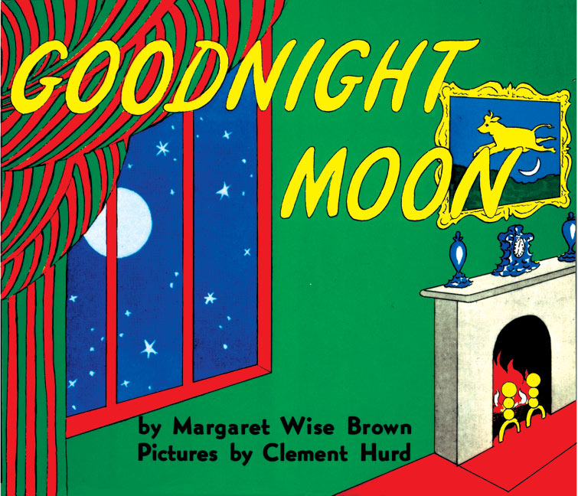

Slide 7
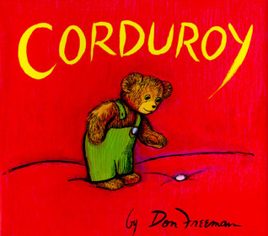

Slide 8

Why read to children?
Through reading, children…
Discover new things
Learn new vocabulary
Recognize letters of the alphabet
Explores imagination
Better express emotions
Bond with caregivers
Enhance memory

Slide 9
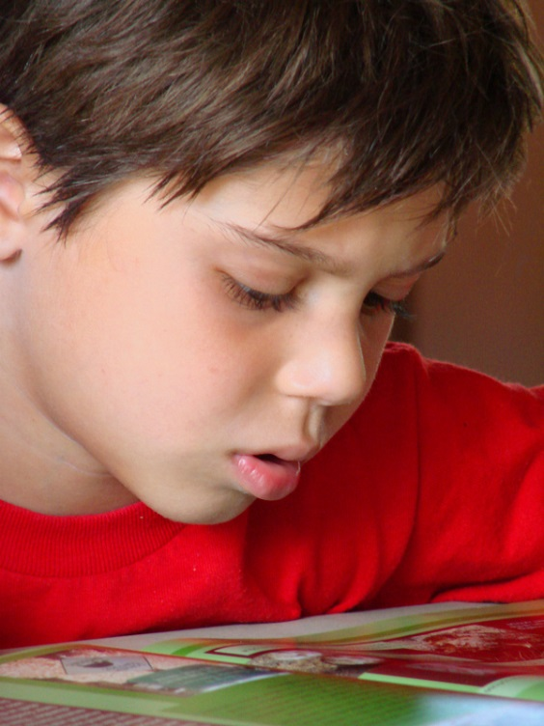
What do books teach children?
Vocabulary
Word pronunciation
Speaking skills
Routine
Imagination
Fine motor skills
Word recognition

Slide 10
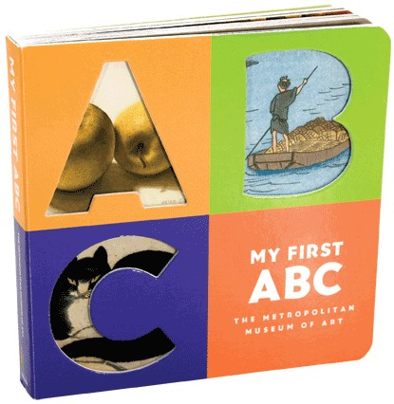
Age-Appropriate Books
Infants
Board books
Bright simple illustrations
Few words
Sensory stimulation
Basic concepts

Slide 11
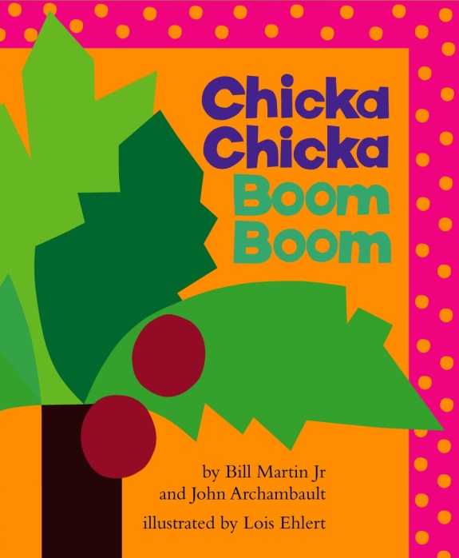
Age-Appropriate Books
Preschoolers
Simple plot
Rhythm
Repetition
Colorful illustrations
Match child’s interest (ex. Trains, princesses, food, etc.)

Slide 12
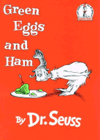
Age-Appropriateness
Kindergarten
Simple text
Recognizable characters
Stories about everyday life

Slide 13
What makes a good storyteller?
When reading to kids…
Change facial expression
Use a variety of voices and tones
Allow for eye contact
Use appropriate volume
Speak clearly
Make pictures visible
Allow for discussion and interaction

