Slide 1
Food Lab Equipment
BINGO

Slide 2
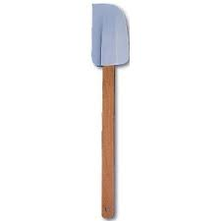

Slide 3
Rubber Scraper
Used to remove soft or liquid ingredients entirely from a bowl or container.

Slide 5
Blender
Use to crush ice, make smoothies, blend ingredients

Slide 7
Muffin Pan
Used for baking muffins or cupcakes

Slide 8
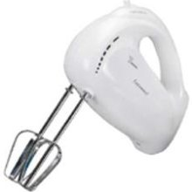

Slide 9
Electric Mixer
Used to cream (add air to) or combine ingredients thoroughly.

Slide 11
Jelly Roll Pan
Used to bake bars or cookies

Slide 12
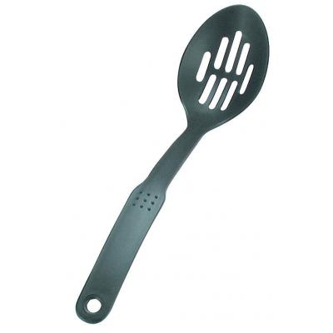

Slide 13
Slotted spoon
Used to remove solid ingredients from liquid

Slide 15
Cookie sheet
Used to bake cookies or other food that will not run off the pan.

Slide 16
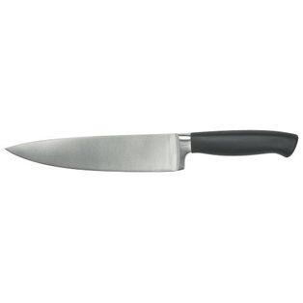

Slide 17
Chef’s knife or French knife
All-purpose knife used for chopping and sectioning

Slide 19
Pastry Blender
Used to blend or cut fat (butter, shortening, margarine) into flour, sugar, and other dry ingredients.

Slide 20
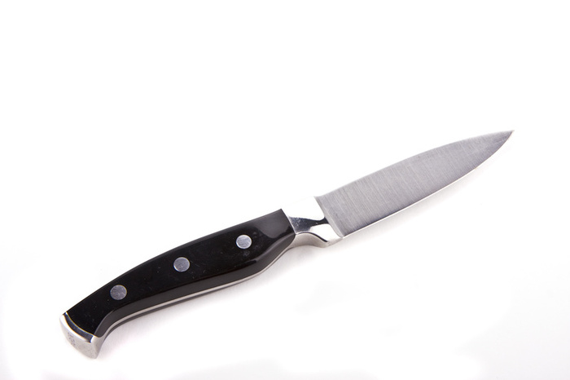

Slide 21
Paring knife
Used for slicing, peeling, or sectioning small ingredients

Slide 22
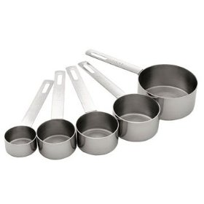

Slide 23
Dry measuring cups
Used for measuring dry ingredients like rice, flour, or even semi-liquid ingredients like peanut butter

Slide 24
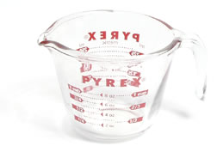

Slide 25
Liquid measuring cup
Used for measuring liquid ingredients like oil, water, and syrup

Slide 27
Peeler
Removes skin from potatoes, apples, carrots, radishes, etc.

Slide 28
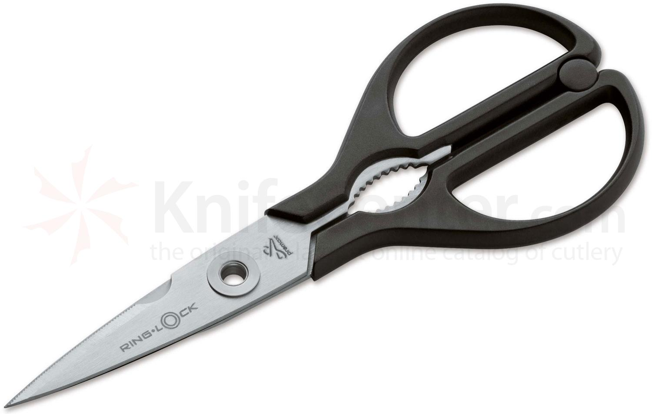

Slide 29
Kitchen Shears
Used to cut open packages and cut food; wash and dry just as you would a kitchen utensil

Slide 31
Tongs
Used to transfer or move medium/large food particles.

Slide 32
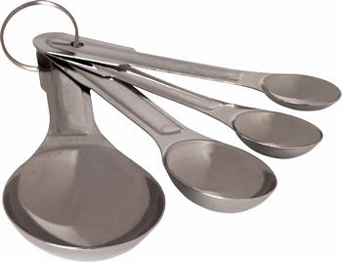

Slide 33
Measuring spoons
Used for measuring small amounts of dry or liquid ingredients

Slide 34
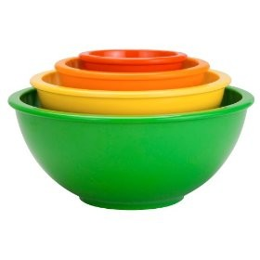

Slide 35
Mixing bowls
Used for storing ingredients and mixing ingredients

Slide 36
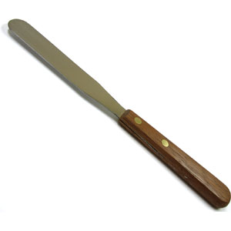

Slide 37
Spatula
Used for leveling ingredients or spreading

Slide 38
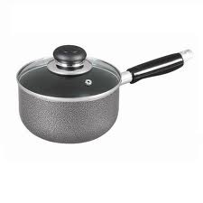

Slide 39
Sauce pan
Used for heating sauces and small amounts of liquid ingredients

Slide 40
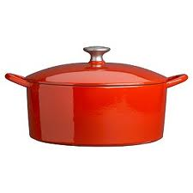

Slide 41
Cooking Pot
Used for stews, soups, and one-dish meals

Slide 43
Whisk
Used to mix ingredients or add air to ingredients

Slide 44
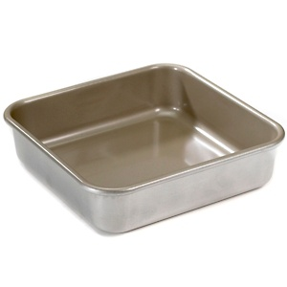

Slide 45
Cake pan
Used for baking cake, bars, and sometimes casseroles

Slide 46
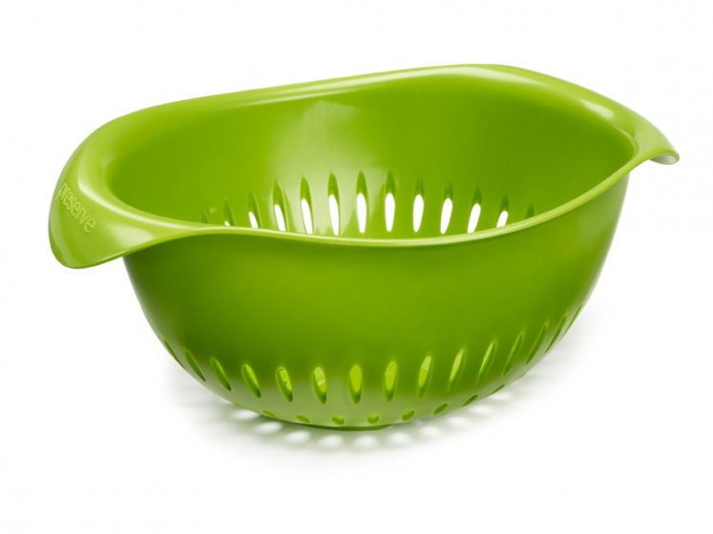

Slide 47
Colander
Used to remove liquid from pasta

Slide 48
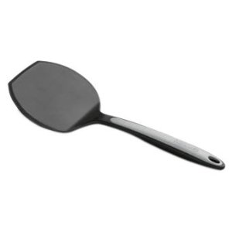

Slide 49
Turner
Used to remove food items, turn food, and serve food

Slide 50
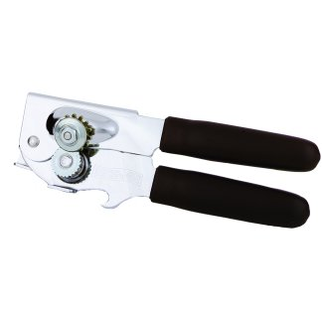

Slide 51
Can opener
Used to open cans

Slide 52
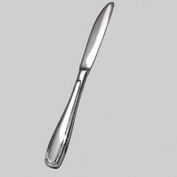

Slide 53
Dinner Knife
Part of a table setting. May also be used to level ingredients for measuring or spreading.

Slide 54
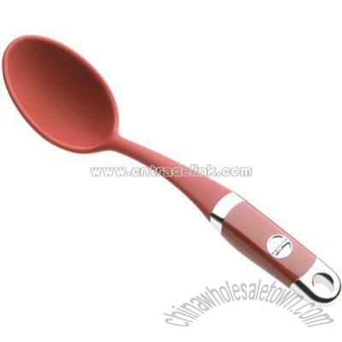

Slide 55
Basting Spoon
Used to remove serve or move liquids

Slide 56
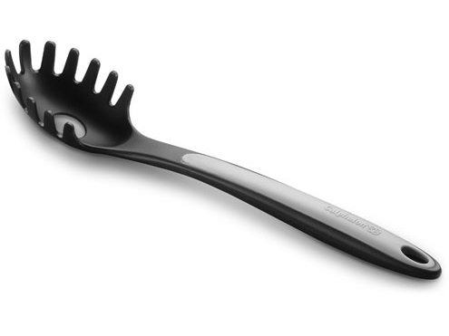

Slide 57
Pasta Fork
Used to serve pasta

Slide 58
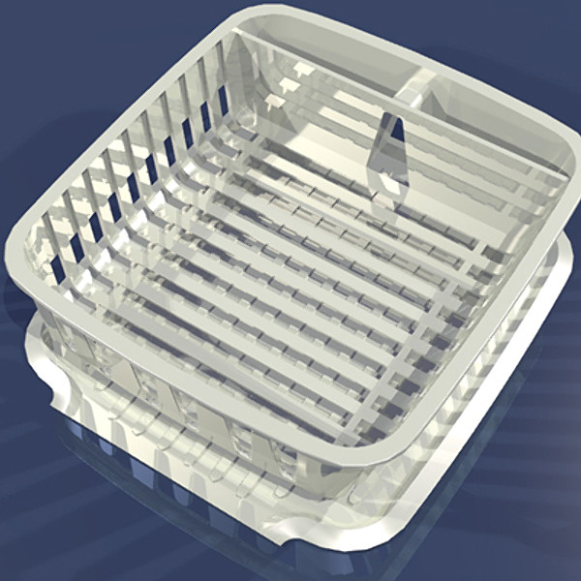

Slide 59
Dish Drainer
Used for drying dishes or storing until dried and put away

Slide 60
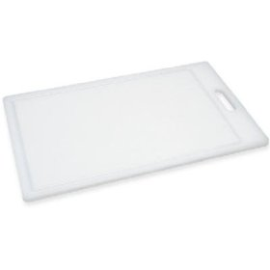

Slide 61
Cutting Board
Used with a knife or cutting tool to protect the work surface and knife

Slide 62
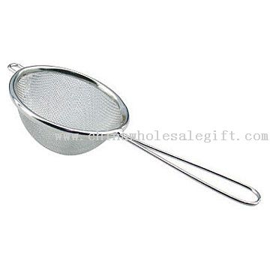

Slide 63
Strainer
Used to drain liquids from foods like fruit, vegetables, and cooked meat

Slide 64
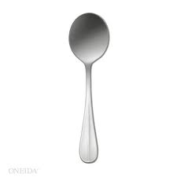

Slide 65
Soup spoon
Part of a table setting, used to consume soup

Slide 67
Salad plate
Part of a table setting, placed above the dinner plate

Slide 69
Ladel
Used to scoop and serve liquids

Slide 70
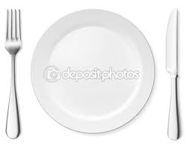

Slide 71
Dinner Plate
Part of a table setting, main meal is served on this

