Slide 1
Lowdown on Laundry
Notes:
‹#›

Slide 2
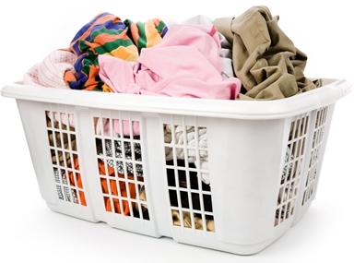
How would you sort this?

Slide 3
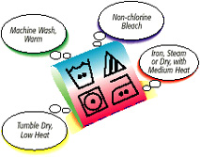
It all starts with the LABEL
http://www.textileaffairs.com/lguide.htm.

Slide 4
The Skinny on Sorting
Colors- separate whites colors and light colors from dark colors
Fiber- fibers should be sorted according to care method and fiber characteristics
Construction- knit items, lace trim, sweaters, and hand wash items require a delicate cycle or washing in a laundry bag to protect the items from snags, and other damage.
Texture- some fabrics attract lint (sweatshirts, sweaters, corduroy). Lint givers should NOT be washed with lint-receivers. No towels with sweaters!!
Soil- heavily soiled work or play items need to be washed separately from other items to prevent transferring of dirt and grease. Wash your grubbies separately from your good clothing.

Slide 5
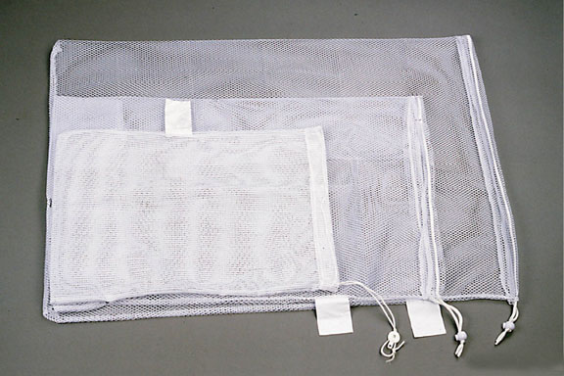
Preparing the Wash
Empty pockets- tissue, crayons, lipstick, and pens will cause a problem in the washing machine or cause stains on your clothing
Shake loose dirt from clothing before washing
Close zippers and button buttons so they do not snag items
Fix rips and tears- washing will make them worse
Put delicate items in a laundry bag
Pre-treat stains
Turn clothing inside out if needed

Slide 6
Stain Removal
Stain removal products help remove stains. The more quickly a stain is pretreated the easier it is to remove. Some common pre-treatment brand examples are SHOUT, STAIN OUT, OXY CLEAN, Etc…
Soaking clothing helps to remove soils from garments. Soak oily stains in warm water, and all other stains in cold water. The benefits of soaking occur in the first 30 minutes.
Only soak your clothing in hot water when cold or warm water does not remove the stain. If the water is too hot it will set in your stain.

Slide 7
Stain Experiment
Develop hypothesis
Make stains
Pre-treat
Launder
Conclude

Slide 8
Quick Quiz
Fred has grass stains on his new jeans. He should
Let the jeans sit in the laundry basket until his mom does the laundry next week.
Pre-treat the stains immediately
Throw the jeans away and get new ones

Slide 9
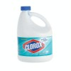
The Buzz on Bleach
Chlorine bleach- Chemical used to
whiten fabrics as well as disinfect and
deodorize.
It can be used for washing fabrics like cotton, but NEVER on silk, wool, spandex, or non-colorfast fabrics (check the label)
Liquid chlorine bleach is extremely powerful and can damage clothing unless diluted. Dilute bleach by pouring it in the bleach dispenser on the side of your machine.

Slide 10
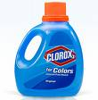
The Buzz on Bleach Cont…
Non-chlorine bleach- identified as
“color safe” or “safe for all fabrics”.
Non-chlorine bleach is used to brighten
fabrics but is not strong enough to
whiten dingy fabrics, or cause damage to the fibers.
It does not disinfect or deodorize and is not used for cleaning purposes.
Non-chlorine bleach should be added and diluted before adding the clothing to the washing machine.

Slide 11
Quick Quiz
Chlorine bleach or non-chlorine bleach?
_____ use on silk, wool, spandex
_____ powerful, can eat holes in fabric
_____ use on white fabric
_____ safe to use on colors
_____ disinfects & deodorizes fabrics _____ dilute with water before adding to washer

Slide 12
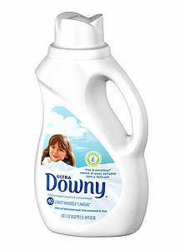
Facts of Fabric Softener
Liquid fabric softener- is diluted
with water and is added to the
final rinse cycle in the
washing machine
Undiluted liquid fabric softener will leave an oily/greasy stain on clothing. To remove pretreat and wash again without adding fabric softener to the wash.

Slide 13
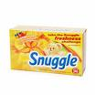
Facts of Fabric Softener Cont…
Dryer fabric softener sheets - are added to the dry cycle. Only use one sheet
per load.
Liquid fabric softener and dryer sheets contain a wax like substance; therefore, using too much can cause clothing to become less absorbent. (such as towels and sheets)
The purpose of dryer sheets and liquid fabric softener is to reduce wrinkles, reduce static, add fragrance.

Slide 14
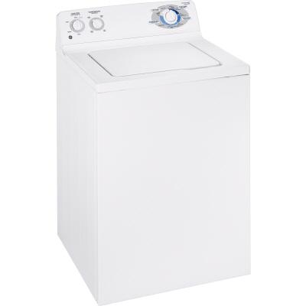
Washing Machine Basics
Temperature control-
choose hot, warm,
or cold
Size of load- Large,
medium, and small
Cycle select-

Slide 15
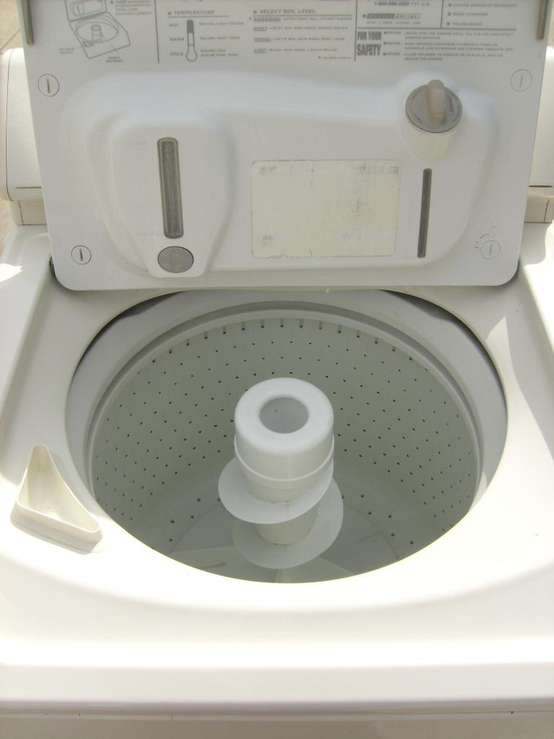
Inside the Machine
Agitator – spins in the middle of the machine
Bleach dispenser
Liquid Fabric Softener dispenser
Each machine may be different

Slide 16
Water Temperature
Cold Water- used for bright and light colors, slightly dirty items and wool. Cold water does not fade colors or cause colors to bleed together.
Hot Water- used for white towels, bed sheets, under garments or items that are very dirty. Hot water can cause colors to fade but is a good choice for removing stains and germs.
Warm Water is a good choice for stain removal. Wash neutral colors in warm water.
**Remember that hot water removes stains best, but can quickly set in your stain.

Slide 17
Wash Cycles
Regular Wash Cycle - used for cotton, denim, linens (sheets and towels), and heavily soiled clothing. This cycle provides heavy agitation to help remove soil.
Permanent Press- used for washing wrinkle free and no iron items, polyester, and nylon. This cycle provides a cool rinse to help prevent wrinkling of fabrics.
Delicate- used for washing sheer fabrics, knits, woolens, and hand washable items

Slide 18
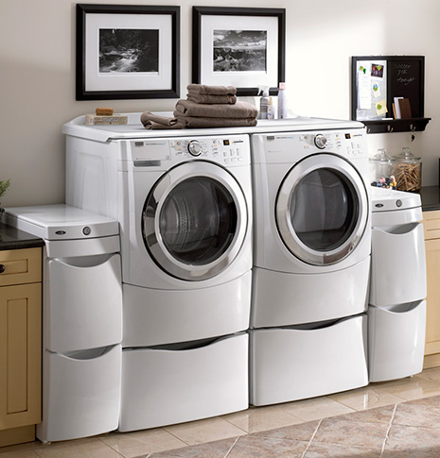
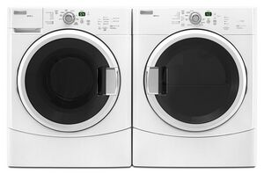
Energy saving washer and dryer

Slide 19
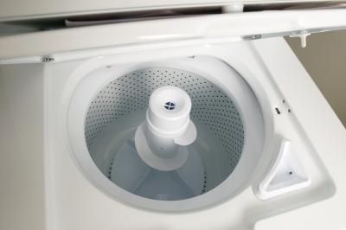
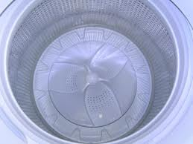
Conventional vs High Efficiency
Agitator Wash Plate
http://www.youtube.com/watch?v=X5hD_iuwn9o

Slide 20
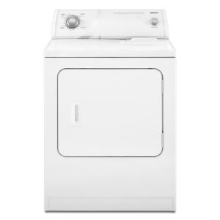
Dryer Basics
Cycle Select
Start Button

Slide 21
Details of Drying
Regular Cycle – high heat is used to dry towels, jeans, undergarments, etc…
Permanent Press - medium heat is used to dry items that are no-iron, such as nylon, acrylic, and polyester
Air Fluff - used no heat to dry, so it is great for drying items that are delicate or may shrink.

Slide 22
Details of Drying Cont…
Over drying fabrics will cause items to shrink and wrinkle
Prevent wrinkling (and having to iron) by…
Removing items immediately from dryer
Hanging items when slightly damp
Use fabric softener
Use permanent press cycle

Slide 23
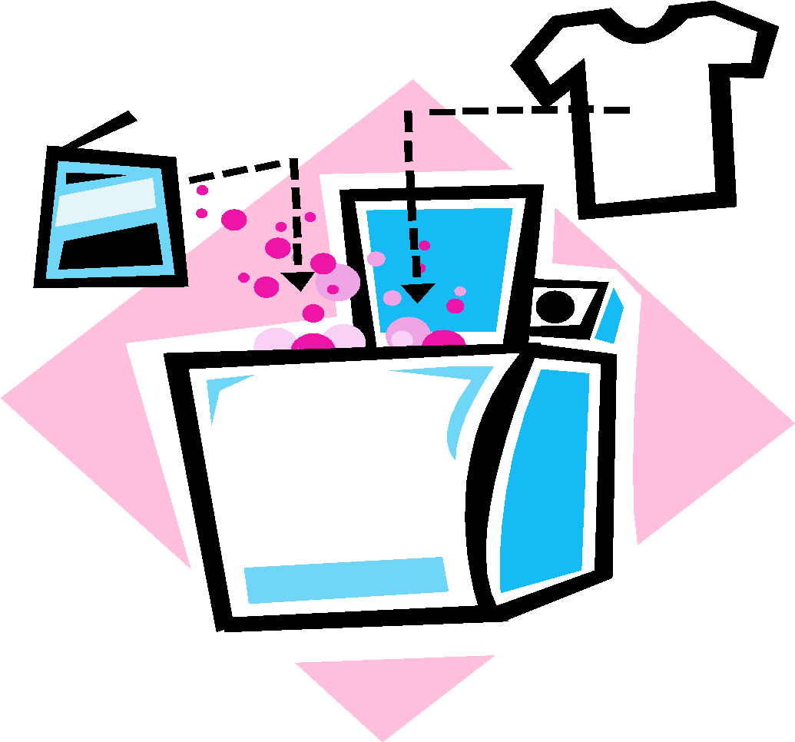
Laundry Tips
Add proper amounts of detergent
Don’t overload machines
Read care label on garments
Clean out lint trap or filter
Separate lint givers from lint receivers
Load garments evenly around agitator or wash plate

Slide 24
Quick Quiz
Mary dislikes her clothing looking wrinkled, but does not want to iron all of her clothing. What can she do to prevent wrinkling without ironing?

Slide 25
Laundry Problems
__1. Snagged sweater a. water and dryer too hot
__2. Graying of whites b. zipper or hooks not fastened
__3. Lint on clothes c. not enough detergent
__4. Wrinkled clothes d. didn’t take out of dryer right away
__5. Clothes shrunk e. moths, mice, or didn’t fix rip
__6. Holes in fabric f. washed something fuzzy

Slide 26
Energy Saving Tips
Select correct water temperature. Hot water uses more energy
Select correct load size. Using too much water is wasteful
Pay attention to drying time. Over drying is a waste of energy

Slide 27
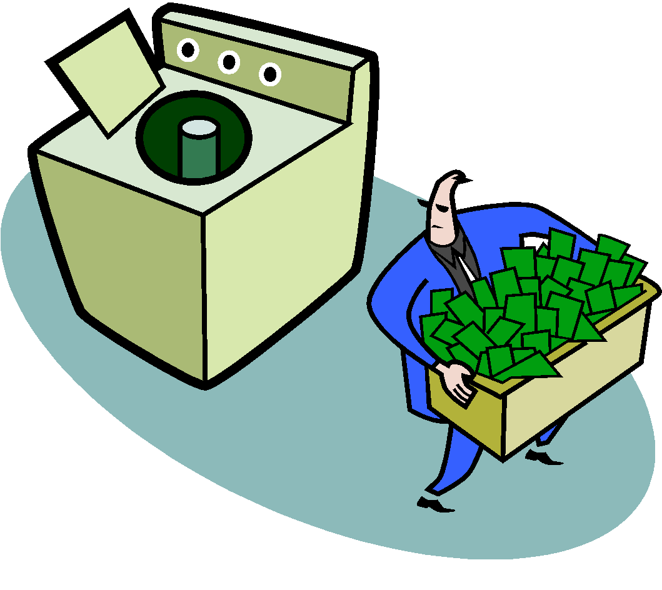
Energy Saving Tips Cont…
A clean lint filter saves energy
High Efficiency (HE) washers were designed to use less water, provide more effective rinse cycles and use less detergent (be sure and use the HE laundry products)

Slide 28
Drycleaning
Drycleaning does not use water to clean your clothing. Use the following link to learn how drycleaning works.
http://www.youtube.com/watch?v=yTMuJmZDPkA

