Slide 1
Planet Paycheck
Vocabulary Review

Slide 2
Three Ways to be Paid
Payroll card
Direct deposit
Paycheck (least secure way to be paid…why?)

Slide 3
Pay Period
The length of time for which an employee’s wages are calculated. May be weekly, bi-weekly, or monthly.

Slide 4
Gross Income
The total amount you are paid before deductions.

Slide 5
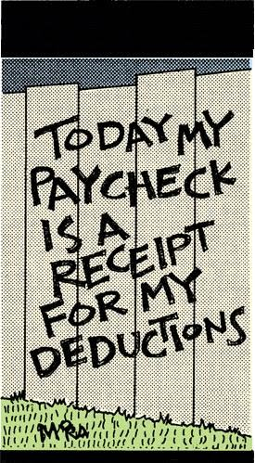
Net Income
The amount of money a person actually takes home.

Slide 6
W-4 and I-9
The two forms every person is required to complete before being hired.

Slide 7
I-9
The form that shows if a person is eligible to work in the United States that shows legal residency or permission to work here.

Slide 8
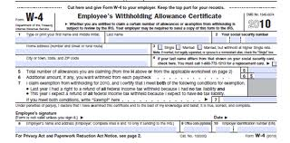
W-4 Form
Form used to report how much money is going be withheld for taxes each year.

Slide 9
W-4 Form and Earnings
Two things that determine the amount of taxes withheld from a paycheck

Slide 10
Withholding Taxes
Amount of taxes, required by law, to be withheld from the paycheck.

Slide 11
FICA
Federal Insurance Contribution Act
A U.S. law requiring a deduction from paychecks and income that goes toward the Social Security program and Medicare. Both employees and employers are responsible for sharing the FICA payments.

Slide 12
Social Security and Medicare
Two deductions under the FICA heading.

Slide 13
Medicare
Hospital and medical insurance for the elderly and disabled.

Slide 14
W-2 Form
The form used to report annual salary and money paid toward taxes. It is used to file income taxes.

