Slide 1
Welcome to Family and Consumer Sciences
Come along as we learn and review classroom routines and procedures!

Slide 2
Make recipe card about yourself
Turn it into the turn-in box
Choose a station to work at (max of 5 people per station)
Follow/read the directions
Carry your must-carries with you
Ask, if you have questions
Follow SOAR
Avoid sitting on tables and countertops
Leave the station the way you found it
Remain in the station area until ready to move; no wandering
Keep hands off of supplies unless you need them for the station

Slide 3
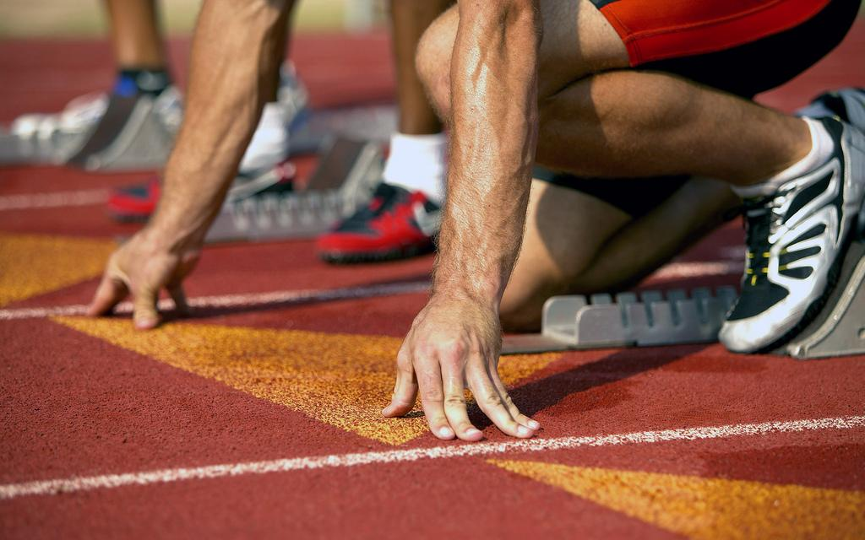
To start each period...
Get your file folder (this will be given to you later)
Sit in your teacher-assigned seat
Write in your planner daily
Add to your goals and targets charts and evaluate learning

Slide 4
Must-Carries
Students are expected to come with these items every day to class:
Binder
Paper
Planner
Writing utensil
Free reading book

Slide 5
Student Supply Station
Counter located between the classroom area and the food labs:
Lost pens and pencils
Markers
Colored pencils
Rulers
Magazines for cutting, scissors, glue
Hair ties
6th, 7th, 8th turn-in tub (make sure to find correct file)
Tissue
*Items are for student use. Return borrowed items to the correct location.

Slide 6
Technology/Phone Policy
Cell phones and other technology should not be visible in the classroom!
First time: Warning
Second time: Teacher’s desk until the end of the period
Third time: Technology is in office until the end of the day
Fourth time: Technology is in the office until the end of the day, call home
*Policy does not restart every day!

Slide 7
Tardy Policy
Warning
Warning
15 min. detention, call home
15 min. detention, call home, level one referral
30 min. detention, call home, level one referral
*If you are late because of a teacher...get a pass!

Slide 8
Bathroom/Drinks During Class
Fill out planner
Bring to teacher for signature and permission
Sign out/sign in at the door
*Three SOAR tickets can be used if you’ve run out of bathroom passes

Slide 9
SOARing in the FCS Room
Each period has a chance to earn three beads for...
...being SAFE and ORDERLY in the classroom (sitting in assigned seats; keeping hands and feet to oneself)
...ACHIEVING (completing the assignments and tasks planned for the day
...being RESPECTFUL (using kind words, taking care of equipment, listening when someone is talking)

Slide 10
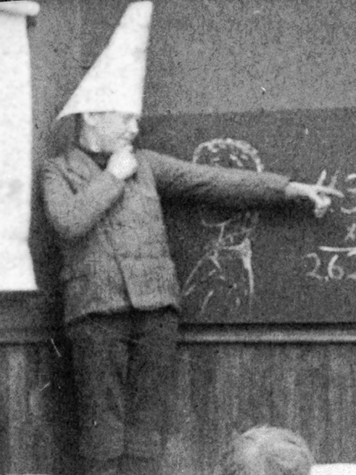
Regroup Area Buddy Room
Go quietly to the classroom regroup area
*It is the teacher’s discretion to write an office referral for both regroup and buddy room.
Ms. Walters/Mr. Bowman in gym or Mrs. Schwarck in the music room
Go directly to that location and check in with the teacher
Sit where assigned
Complete reflection sheet
After 5 minutes, return to class (unless otherwise indicated)

Slide 11
Other
Students are not allowed in the food labs unless given permission, but they can work at the tables when granted permission.
At the end of the period, each person is responsible to put the files back in the box
Students will be dismissed by the teacher

Slide 12
Quiz: What do you Remember?
Number 1-12 and write the letter of the best answer next to each number.

Slide 13
Something that has to be done to start every period is to
Write in planner
Read learning target(s)
Sit in assigned seats
All of the above

Slide 14
2. You will put your file folder in the file box at the end of the period.
True b. False

Slide 15
3. You should bring your must-carries to FCS everyday.
True b. False

Slide 16
4. You must have a planner to use the restroom or get a drink.
True b. False

Slide 17
5. This item is NOT found at the student supply station:
Turn in box
Hair ties
Pencil sharpener
Tissue

Slide 18
6. Which is part of being SAFE/ORDERLY in the FCS room?
Bringing a free-reading book
Finishing all work planned
Listening to the speaker
Sitting in assigned seats

Slide 19
7. The technology policy starts over each day.
True b. False

Slide 20
8. The second time your technology is out, it is
Kept in the teacher desk and returned at the end of the period
Taken to the office
Kept in the teacher desk and parents/guardians are called
Returned to the student after five minutes in the teacher’s desk

Slide 21
9. If you are going to be late because of a teacher, get a pass in your planner.
True b. False

Slide 22
10. The second time you are tardy you will be given a…
Warning
Detention
SOAR ticket
Level 1 referral

Slide 23
11. One way to earn a SOAR ticket is to…
Have your planner filled out on a random day
Asking a classmate that is alone to work with you
Being student inspector on lab days
All of the above

Slide 24
12. At the end of the period…
Leave as soon as the classroom clock says the right time
Wait for teacher dismissal
Line up outside the classroom
Stack your chairs in groups of four

Slide 25
Check Your Answers
1.D
2. T/A
3. T/A
4. T/A
5. C
6. D
7. B/F
8. A
9. A/T
10. A
11. D
12. B

