Slide 1
Why Does It Matter What We Eat?
Healthy Eating

Slide 2
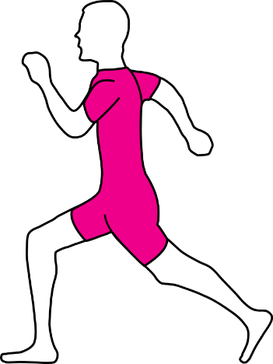
The Facts
There are many reasons (1) that we have to eat and there are many influences (2) affecting what we eat.

Slide 3
The Facts
Ultimately, food provides the nutrients (3) that our body systems need to grow and reproduce.
The six essential nutrients are
4. vitamins
5. water
6. protein
7. fat
8. carbohydrates
9. minerals
By consuming a diet consisting of the above foods, we are consuming a diet that is nutrient-dense (10).

Slide 4
The Facts
Poor food choices can also lead to other health conditions such as, obesity (11), hypertension (12), and heart disease (13).
One major reason we eat is for calories(14) and energy.
Our calorie needs vary based on
Gender (15)
Age (16)
Activity levels (17)
Height (18)
Weight (19)
Metabolism (20) is how fast our bodies burn calories

Slide 5
Diet-related diseases and special health conditions can affect what we do and don’t eat.
Obesity
Hypertension (High Blood Pressure)
Type 2 Diabetes
Certain cancers
Student Athlete
Lactose-free
Anemia
Celiac Disease
High Cholesterol
Osteoporosis
Pregnancy

Slide 6
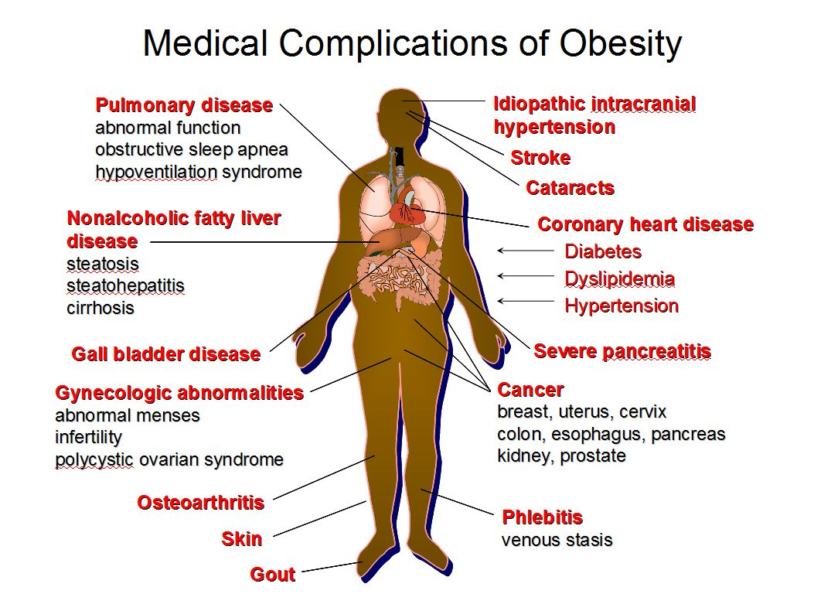
Obesity
Description
BMI – Adult body mass index of greater than 30
http://kidshealth.org/teen/food_fitness/dieting/bmi.html
Leads to other health issues

Slide 7
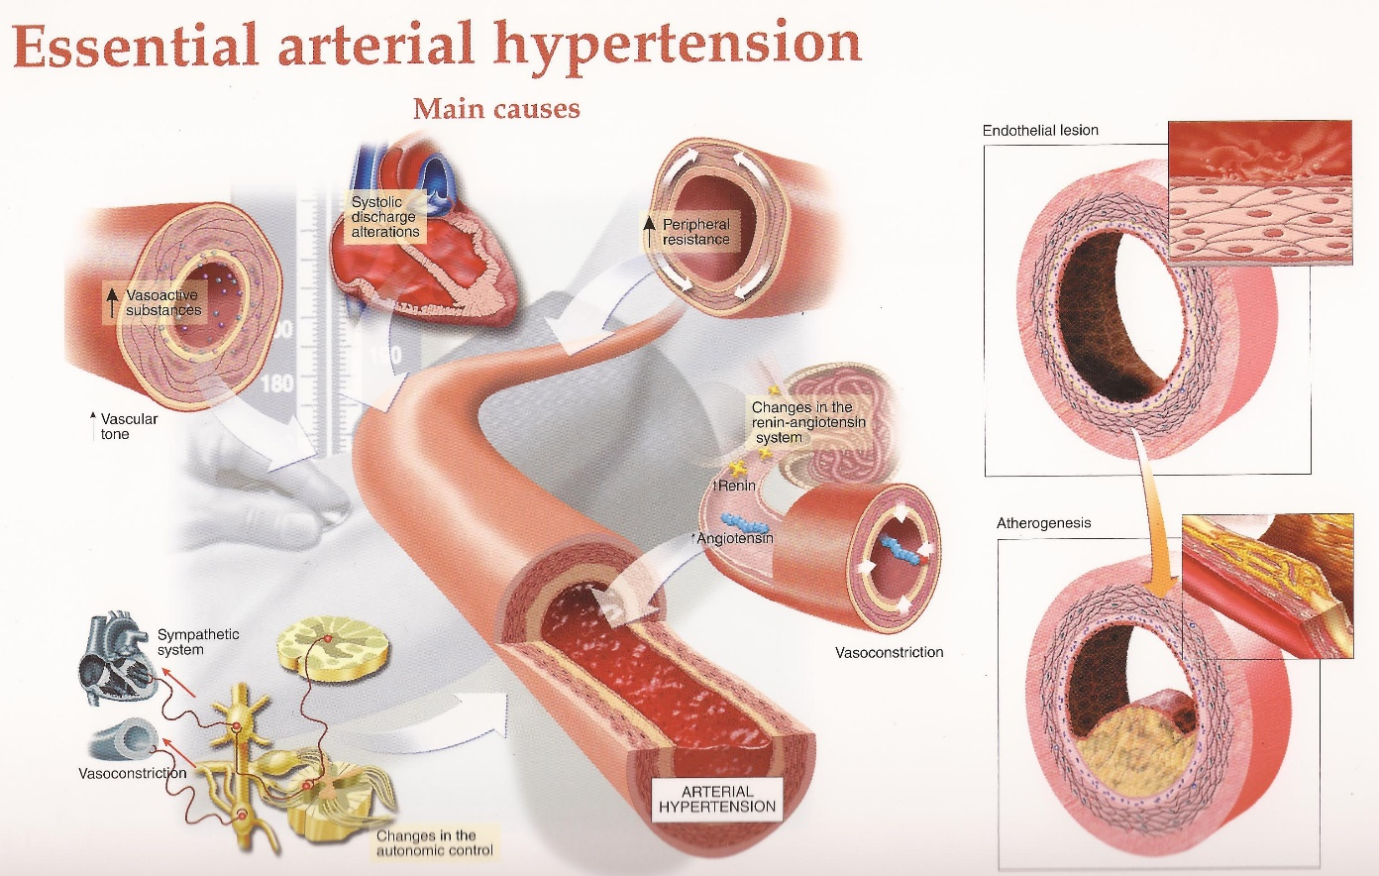
Hypertension (High Blood Pressure)
Description
The pressure of blood against our vessels and arteries
Most common in adults
Less than 120 over 80 is considered a normal
Can be inherited
Puts a person at more risk for strokes, heart attacks, kidney failure, loss of vision, and atherosclerosis (hardening of the arteries)

Slide 8
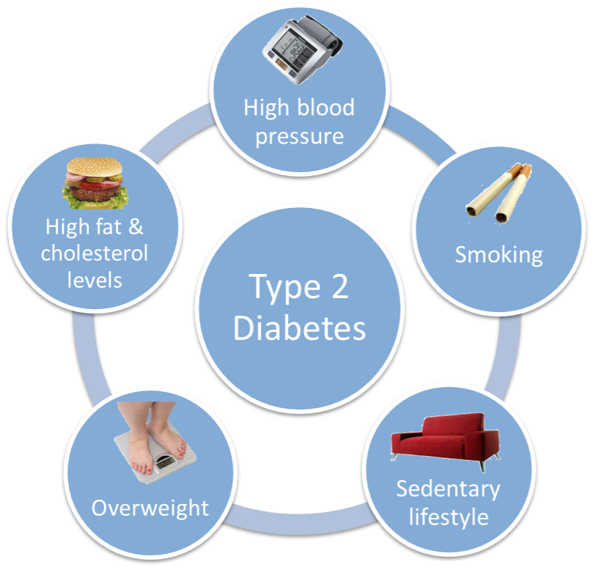
Type 2 Diabetes
Description
Disease that affects how the body uses glucose
A person who is diabetic does not produce enough insulin to help sugar be absorbed into our cells
Most likely in someone who is overweight
Can be genetic
Frequent urination, fatigue, thirst

Slide 9
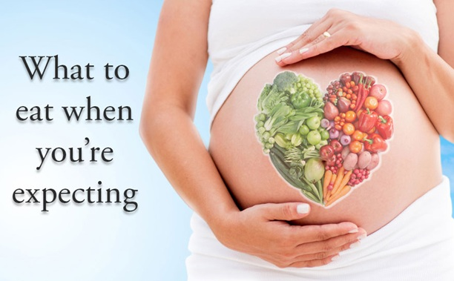
Pregnancy
Description
Need special nutrients to help growing baby
Folic acid

Slide 10
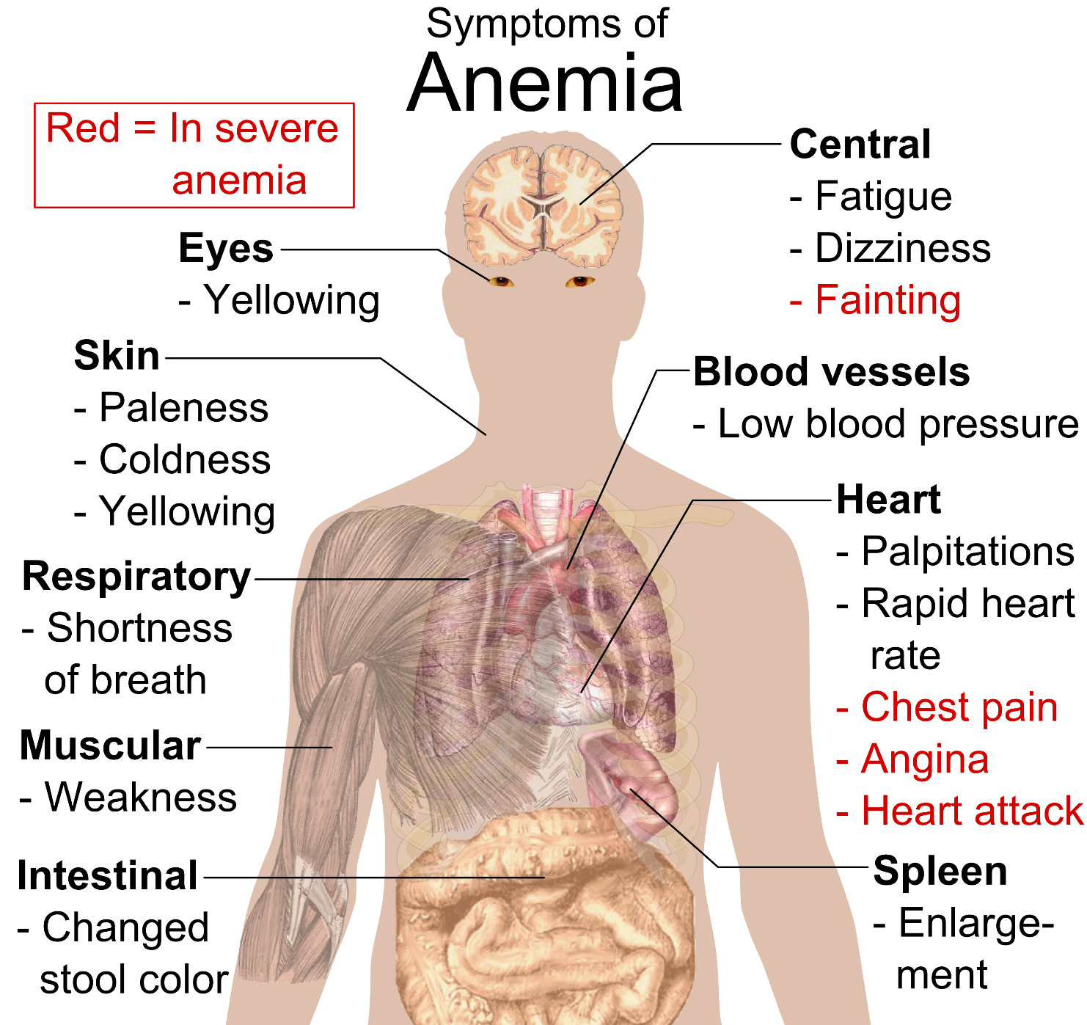
Anemia
Description
Low iron levels in blood
Fatigue
More common in girls due to menstruation
Common during puberty

Slide 11
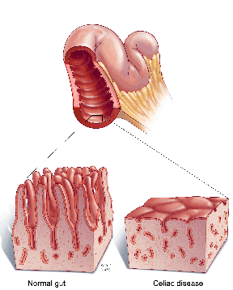
Celiac Disease
Description
Condition that prevents nutrients from being absorbed into the blood
Gluten allergy
Symptoms include diarrhea, abdominal pain and bloating, and weight loss

Slide 12
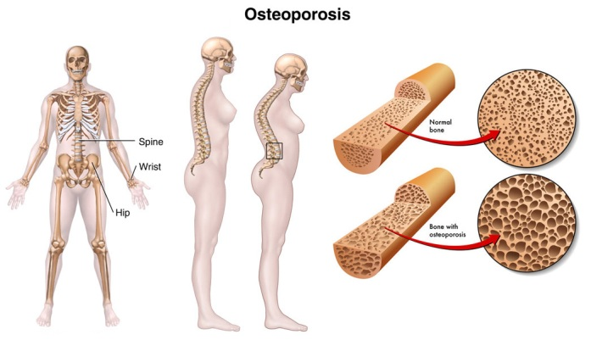
Osteoporosis
Description
Thinning bones
Risk factors for osteoporosis include aging, being female, low body weight, smoking, and some medications.

Slide 13
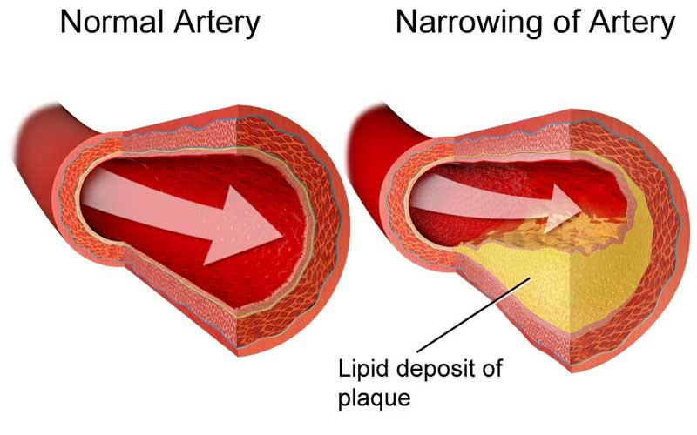
High Cholesterol
Description
Cholesterol is found in saturated fats (mainly animal fats)
Cholesterol sticks to arteries and clogs them
Cholesterol is produced in our bodies
Affected by diet, genetics, age, weight

